Slide 1

SMART INDIA HACKATHON 2026
TITLE PAGE
Problem Statement ID – SIH26034
Problem Statement Title - Software System to check compliance of Packaged Commodities under Legal Metrology(Packaged Commodities) Rules, 2011 by scanning products, images and labels.
Theme - Miscellaneous
PS Category - Software
Team ID - 115
Team Name (Registered on portal) – Hack4Change
"Real-Time Edge AI for Legal Metrology Enforcement"

Slide 2
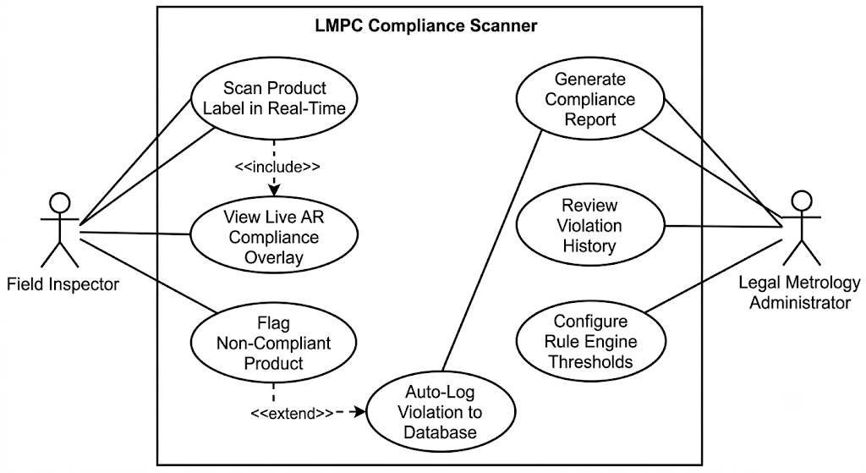
AI-Driven Enforcement Prototype for LMPC Compliance
Hack4
Change
Proposed Solution:
Edge-deployed CV + NLP pipeline: YOLOv8n + PaddleOCR PP-OCRv4 (OpenVINO) + deterministic rule engine.
Zero cloud dependency — runs entirely on the inspector's device.
Real-time AR overlay: green/red compliance verdict rendered directly on the live camera feed.
How it addresses the problem:
Replaces manual, error-prone spot-checks with continuous, objective, real-time screening.
No network dependency → works in low-connectivity rural and semi-urban retail markets.
Innovation and Uniqueness:
Inspector-facing AR tool, not a retailer-facing app; sidesteps retailer adoption friction entirely.
Class-specific routing: text regions go through OCR.
Deterministic, rule-based verdicts instead of a black-box LLM judgment.

Slide 3
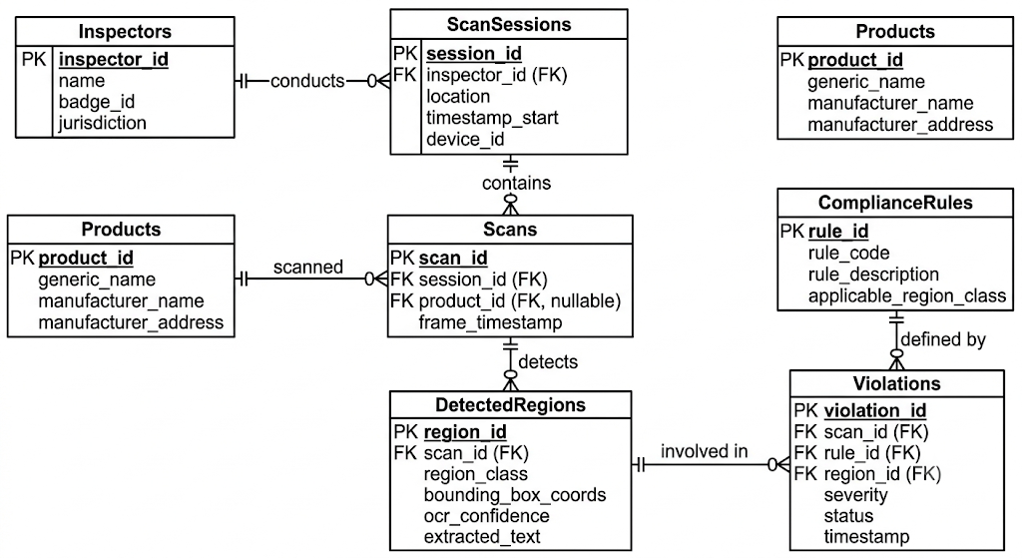
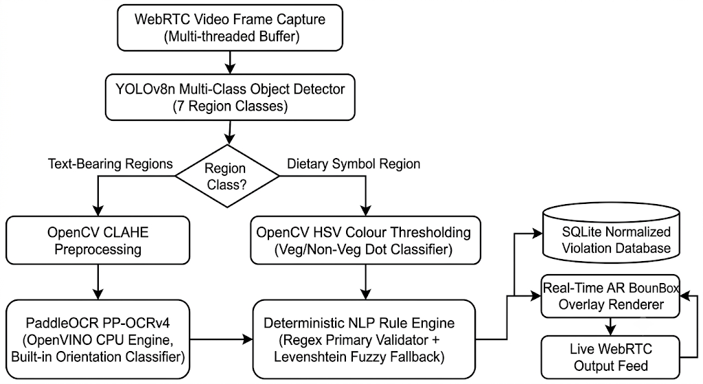
TECHNICAL APPROACH
Hack4
Change
Technologies considered:
YOLOv8n (Ultralytics)
OpenCV, PaddleOCR PP-OCRv4
Intel OpenVINO
Python · Streamlit + streamlit-webrtc
SQLite / MariaDB MySQL
Roboflow (annotation + augmentation)
Methodology:
Continuous WebRTC capture/ upload pictures manually.
YOLOv8n detects 7 label-region classes (expandable).
Text classes → OpenCV CLAHE contrast enhancement → PaddleOCR PP-OCRv4 (OpenVINO, CPU) with built-in orientation classifier.
dietary_symbol_region → OpenCV HSV thresholding (green/brown dot classifier) — bypasses OCR entirely
Transcribed text → deterministic NLP rule engine: regex-first match against the LMPC Rule 6 checklist, Levenshtein fuzzy match (ratio > 0.85) as fallback only.
Verdict + metadata written to a normalized SQLite schema
(Training-time only) Roboflow: 3× offline augmentation.

Slide 4
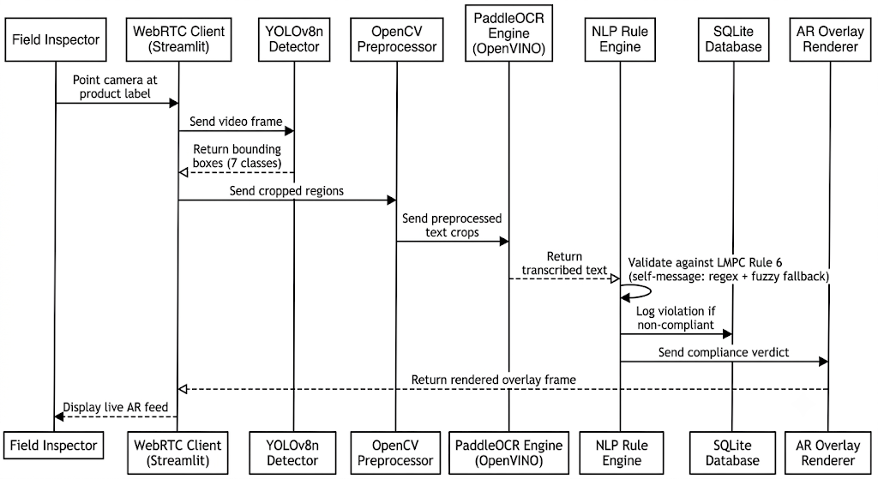
FEASIBILITY AND VIABILITY
Hack4
Change
Prototype Feasibility:
Pipeline designed to run within a 4GB VRAM ceiling by CPU-offloading OCR.
PP-OCRv4's mobile recognition variant is published at ~11MB, purpose-built for edge/embedded deployment.
Anchor-free YOLOv8n detection head handles the irregular aspect ratios of label text without a fixed-anchor prior.
Potential Challenges and Risks:
Specular highlights and reflections off plastic/foil packaging.
Cylindrical curvature distorting text on bottles and cans.
Label format variation across manufacturers and retailers.
OCR noise from low-resolution or motion-blurred mobile capture.
Strategies to overcome these challenges:
Curvature → PaddleOCR's built-in orientation classifier instead of geometric deskewing, which assumes a flat plane and fails on cylindrical surfaces.
OCR noise → Levenshtein fuzzy fallback (>0.85 ratio) as a safety net only, never the primary validator, so noise can never silently mask a real violation.
Format variation → the 7-class detector plus Roboflow augmentation (rotation/shear/HSV jitter) is trained to generalize across label layouts rather than hardcoding one.

Slide 5
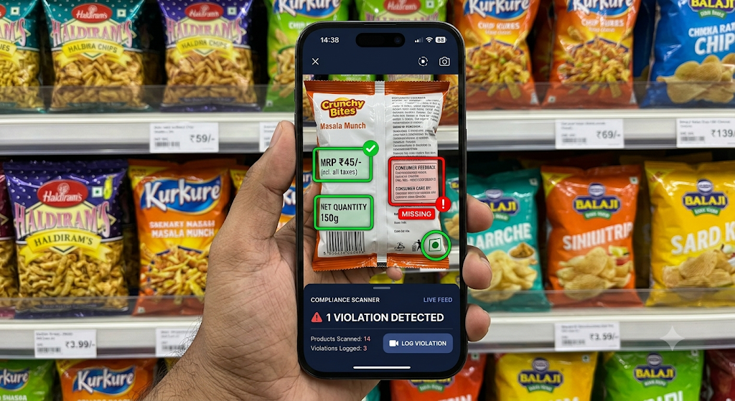
IMPACT AND BENEFITS
Hack4
Change
Potential Impact on the Target Audience:
Gives field officers an instant, objective compliance verdict at the point of inspection
Extends enforcement reach into low-connectivity rural and semi-urban retail, not just urban centres.
Benefits of the solution:
Scales statutory enforcement without scaling inspector headcount.
Shifts enforcement from reactive/manual to continuous/proactive.
Every flagged violation is logged with a timestamp, the specific Rule 6 clause breached, and a Section 36 reference for fine estimation; an audit trail that reduces disputes over ambiguous manual findings.
Deterministic, explainable rule-engine output instead of a black-box GenAI judgment; relevant when the output can support a legal seizure or compounding action.

Slide 6
RESEARCH AND REFERENCES
Hack4
Change
Legal Metrology (Packaged Commodities) Rules, 2011 — Rule 6 (mandatory package declarations), Department of Consumer Affairs, Ministry of Consumer Affairs, Food & Public Distribution, Government of India.
Link: https://consumeraffairs.gov.in/pages/legal-metrology-act
The Legal Metrology Act, 2009 — Section 36 (penalty for selling non-standard packages) and Rule 32 (compounding of offences)
Link: https://www.indiacode.nic.in/handle/123456789/2102
Recognition of expiry data on food packages based on improved DBNet by Zheng, J., Li, J., Ding, Z., Kong, L., & Chen, Q. (2023). Connection Science, 35(1), 1–16.
Link: https://doi.org/10.1080/09540091.2023.2202363
PaddleOCR PP-OCRv4 — official model documentation, PaddlePaddle team
Link: https://www.paddleocr.ai/main/en/version3.x/pipeline_usage/PP-ChatOCRv4.html
Ultralytics YOLOv8 — official documentation
Link: https://docs.ultralytics.com/
Intel OpenVINO Toolkit — official documentation
Link: https://docs.openvino.ai/2026/index.html

